Slide 1
Eventsourcing
Time to rethink data

Slide 2
Who am I?
Siavash Ghassemi
Passionated software engineer since the age of 8
Mobile enthusiast
Cloud enthusiast
Coach
Cloud architect
Business consultant
Microsoft MVP

Slide 3
How we work with data today

Slide 4
Working with Data
Relational Data
Databases
Tables & Views
Stored Procedures
Relations
NoSQL
Columnbase
Documentbased
Key-Value-based

Slide 5
Issues of relational and NoSql
No Auditing
Only currentstate
Data relations not natural
Blocking operations

Slide 6
Reality is different

Slide 7
Reality
Not Blocking
Multitasking
Asynchronous
Eventbased

Slide 8
What if we would handle data like in reality

Slide 9
Event sourcing
No tables
No entities
No relations
Not blocking
Near real-world
Auditing for free

Slide 10
Event sourcing
First work chain of blocks described 1991 by Stuart Haber and W. Scott Stornetta
Described as EventSourcing 2005 by Martin Fowler
Blockchain – 2008 by Satoshi Nakamoto

Slide 11
Event sourcing
Only safe events (transaction log)
Append only data store for events
Ledger
Once created, always true
Current state by replay of all events
Dynamic Views

Slide 12
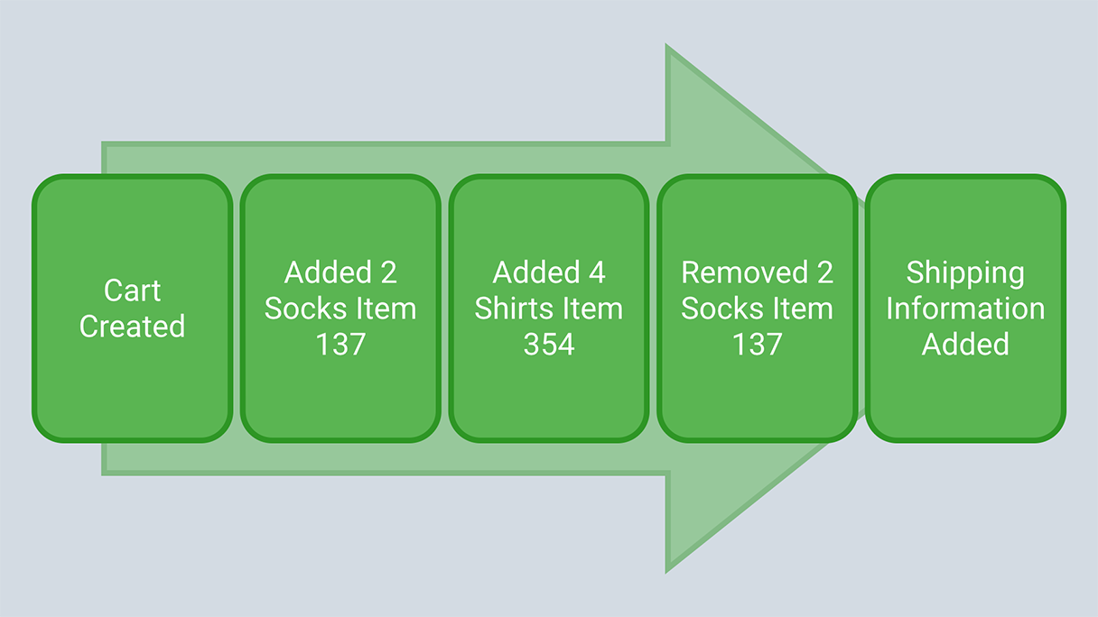
Event sourcing

Slide 13
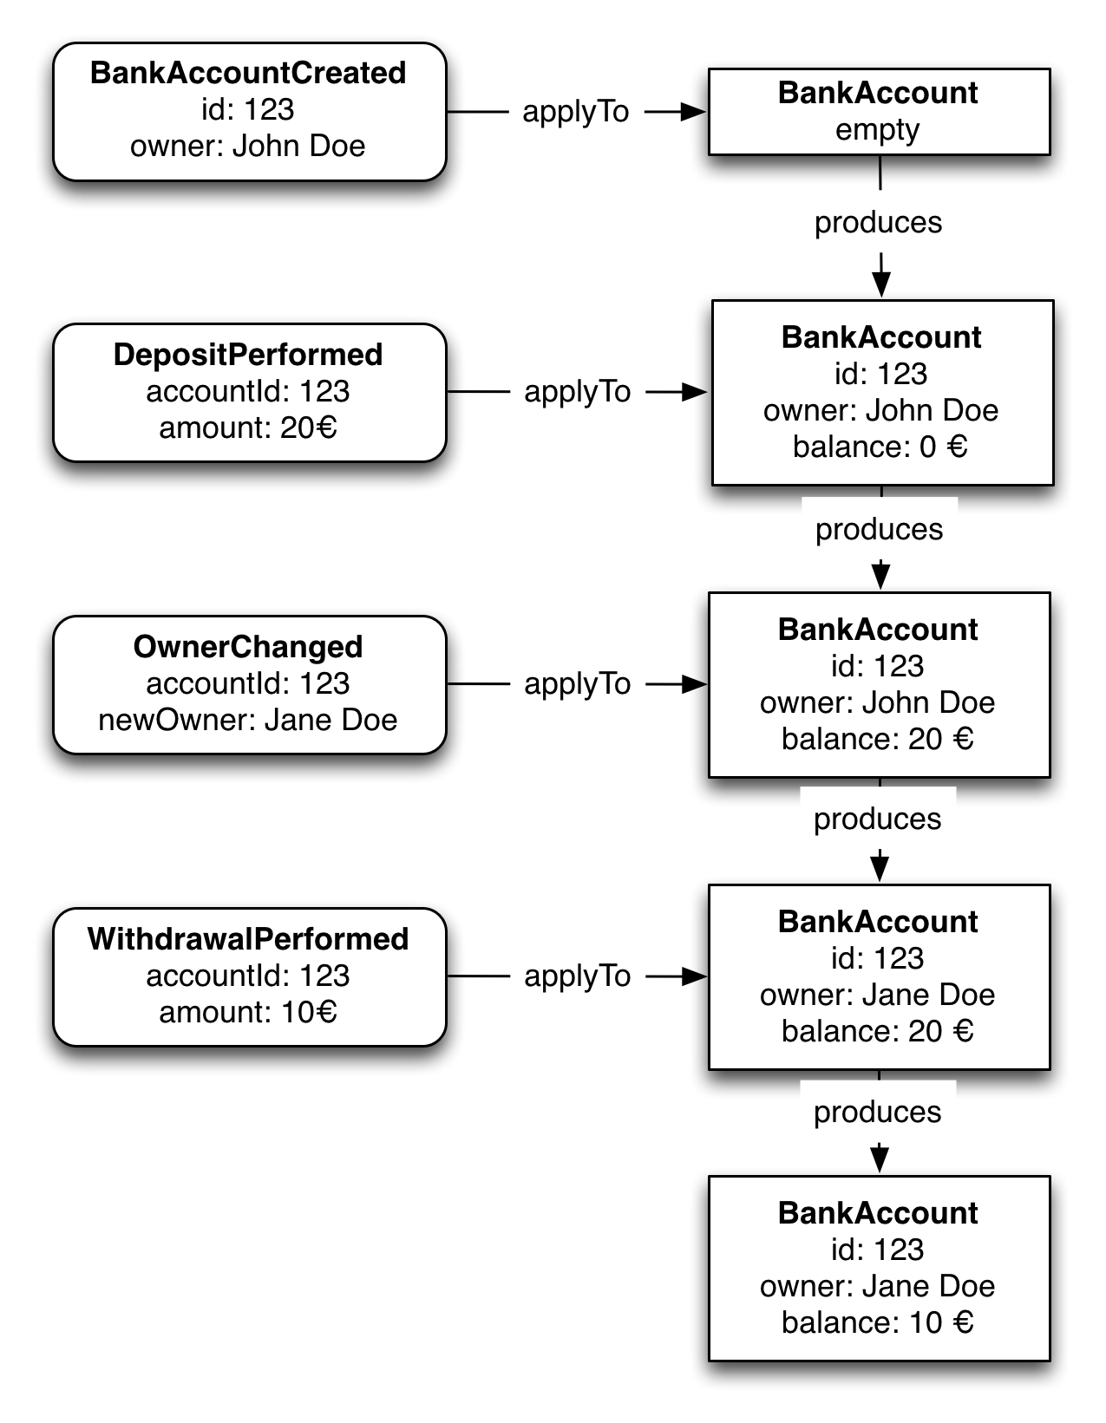
Event sourcing

Slide 14
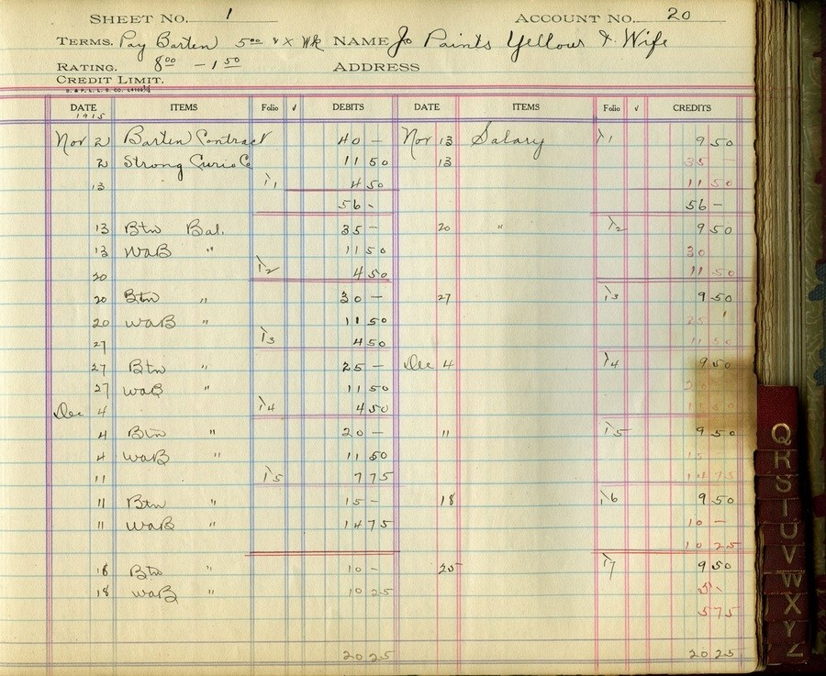
Event sourcing

Slide 15
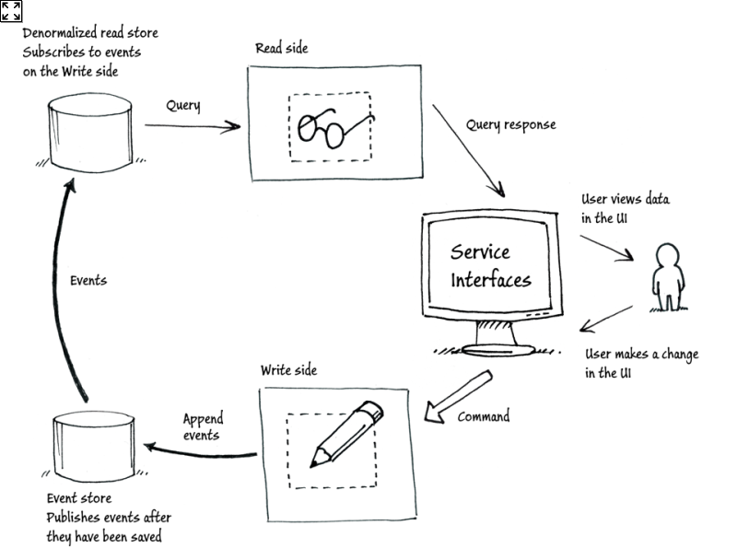
Event sorucing

Slide 16
POssibilities

Slide 17
Possiblities
Create information as I need it
Create information from historical data
Provide information much faster
Be realy agile

Slide 18
Gotchas
Rethinking how to work with data
DDD can help
Training others
EventStorming can help
Building the system again Event Sourced
Automated tests can help

Slide 19
That’s it! Now go out and make the virtual world a better place!

Slide 20
Thank you!

